Slide 1
Bitcoin & Blockchain - What’s next?
Graeme Burnett
Mar 2017

Slide 2
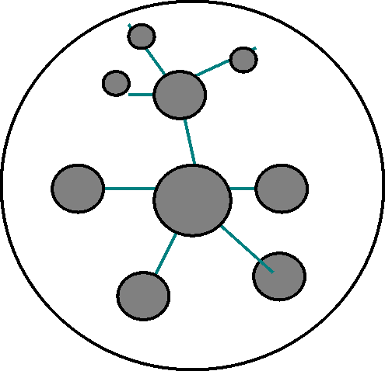
Bitcoin
Mostly used for investment, extortion, blackmail, buying drugs/guns.
Bitcoin won’t be allowed to last. Legislation and law enforcement will catch up eventually.
Governments want to control your money (issuance and retraction) for fraud/criminality detection.
All digital currencies will be forced to add pseudonymity.

Slide 3
Blockchain
Proof of Work and Eventual Consensus
PoW is not the only way
Merkle Trees suffice for most business use cases
Blockchain infrastructure is variable and geographically unbalanced
The China problem
The energy problem

Slide 4
Data Analytics
Huge number of transactions
Invisibles are about to be exposed - i.e. supply chain flow and internal budgets giving much more insight from operational analytics
AI will automate much of the accountancy, payments, credit management functions.

Slide 5
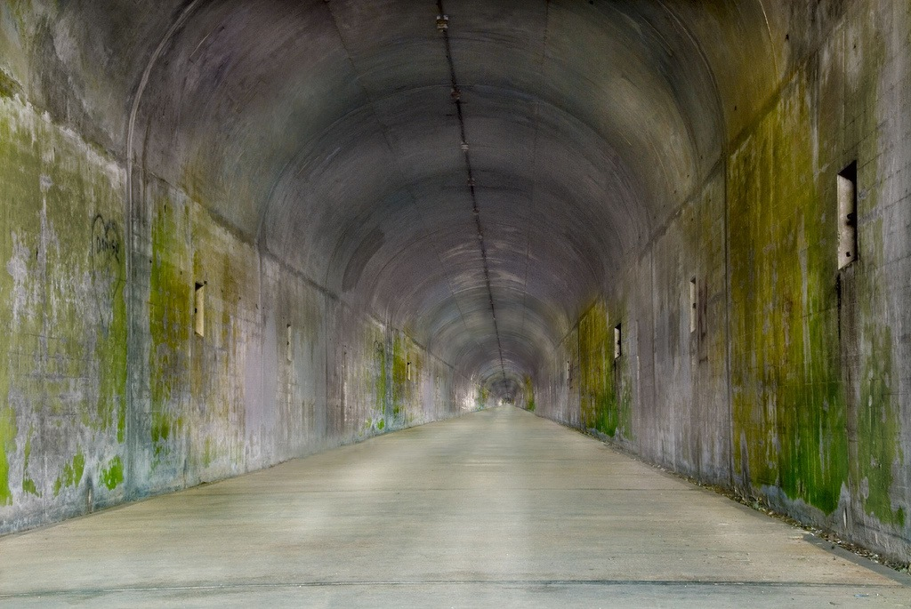
What’s Next?
Bitcoin 2.0: pseudonymous currencies.
Microservices financed by microcash in a reputation based marketplace.
Distributed ledger suffices for most business use cases - Corda has abandoned blockchain
Big Data: Transaction analytics for fraud/anomaly detection but also trend projection. Huge opportunities here.
Schemes: PBFT, RAFT, BFTRaft

